Slide 1
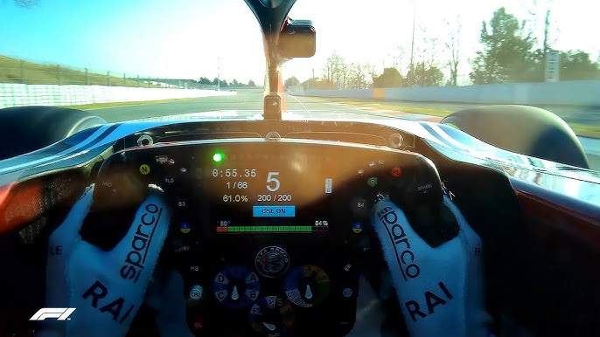
SD 2 – Team 17 Pneumatic Paddle Shifting Test Bench
Margaret Allen, Justin Lischuk, Kaci Walter, Jakob Werle

Slide 2
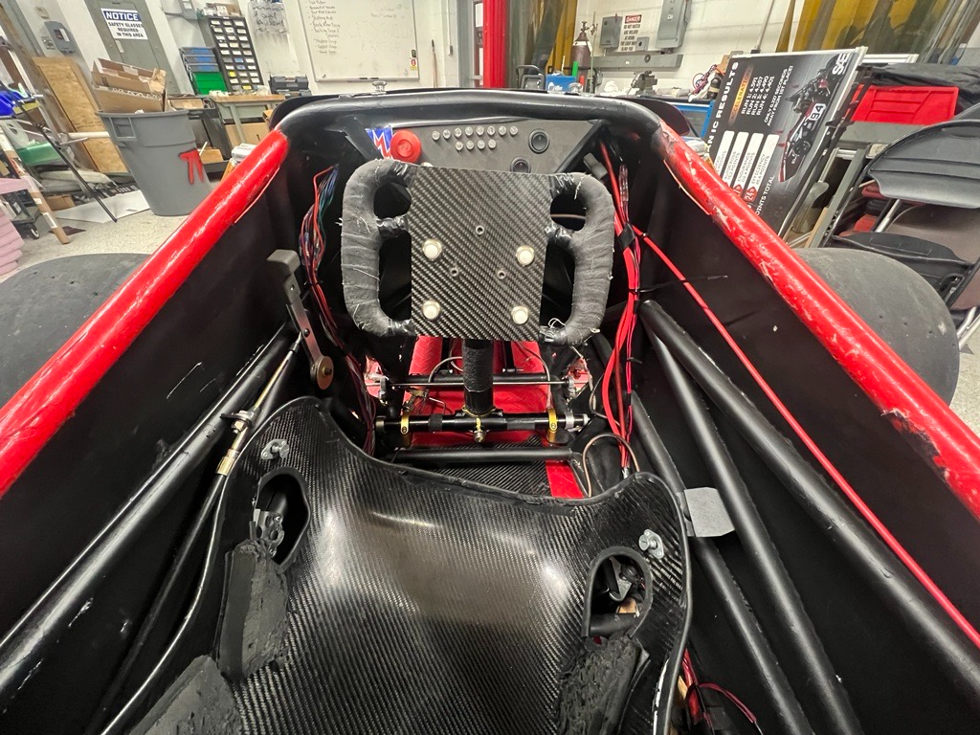
Project Context
Temple Formula Racing (TFR)
Formula SAE collegiate design competition
OEM Honda CBR600RR engine
Manual 6-speed sequential gear box
Mechanical push-pull cable shifting system
Driver must remove hand to shift
Prior SD attempts:
Insufficient documentation and mechanical validation
Previous SD team unsuccessful implementation
Figure 1. Current location of mechanical shifter

Slide 3
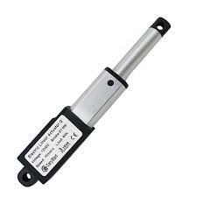
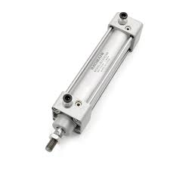
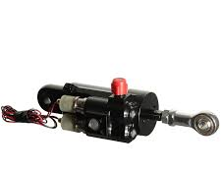
History of Sequential Shifting Systems
Manual shift lever (currently used)
Electronic solenoid actuated system
Electrical cost
Hydraulics actuated system
Bulky, extra power unnecessary
Electro-pneumatics actuated system
Selected
Figure 2. Electronic actuator
Figure 3. Hydraulic cylinder
Figure 4. Pneumatic cylinder

Slide 4
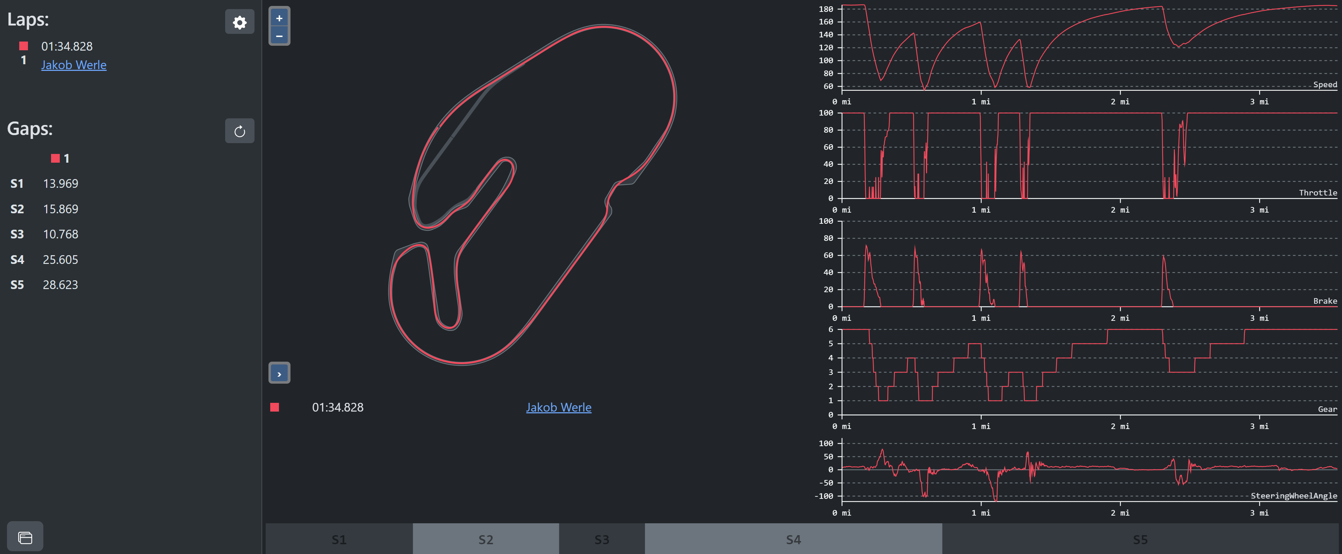

Engineering Problem
FSAE competition requires 50+ shifts per lap
Create shifting mechanism to:
Reduce shift effort
Increase efficiency
Design testing apparatus to perform experiments on components
Correlate collected data to design parameters
Figure 5. Example of driving data (shifting – row 4)

Slide 5
Design Criteria
Priority (negotiable or non-negotiable) | Functional Requirement | Target Value Range, or Pass/Fail | Justification
Non-negotiable | Air cylinder to actuate piston movement for shifting | Pass/Fail | Piston must move with sufficient force to cause a shift in the transmission
Non-negotiable | Collect data from system before, during, and after shifting process | Pass/Fail | Since the project is a test bench, it is important to understand how well the system performs
Non-negotiable | Microcontroller to facilitate interactions between inputs and outputs | Pass/Fail | User must be able to see that system is performing in operating range, and be able to control with inputs
Negotiable | Aesthetic Appeal | Pass/Fail | Spirit of senior design competition
Negotiable | Dashboard | Pass/Fail | Easier for users of system to need to look at a screen and view data live rather than performing post-processing tasks
Table 1. Design Criteria

Slide 6
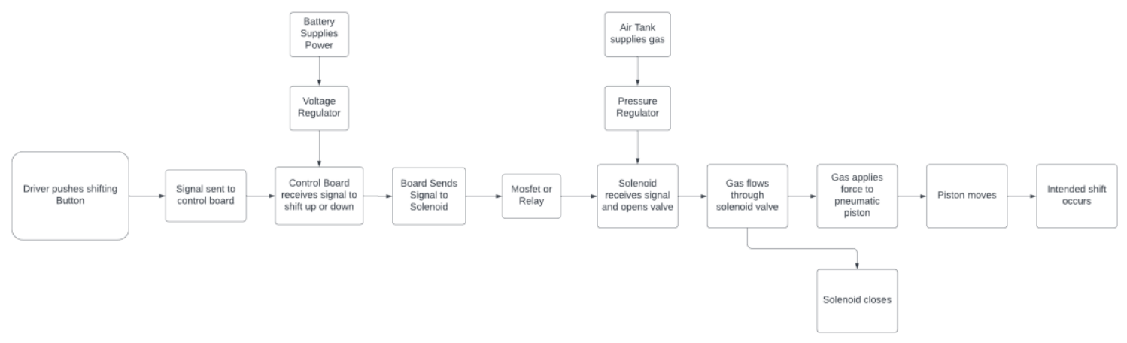
System Block Diagram
Figure 6. Project Block Diagram

Slide 7
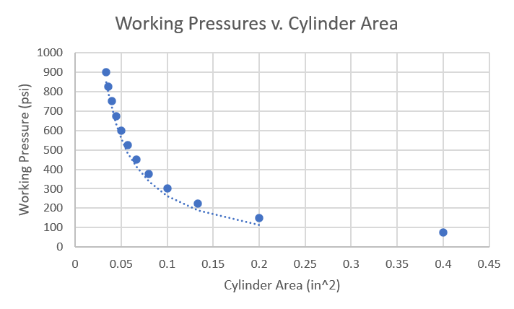
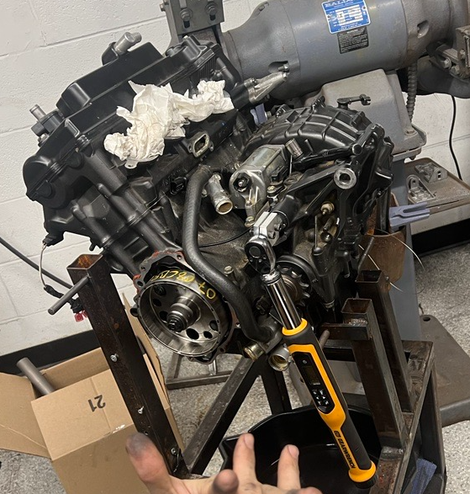
Progress
Current
Compressed Gas Calculator
Outputs theoretical mass per shift based on selected components and compressed gas
Figure 3 displays the working pressure required per the bore area of a pneumatic cylinder
Component Selection
CO2 tank, Nitrogen tank, and solenoid selections are finalized
Compressed CO2 and N2 sources located on campus
Mechanical system designed to determine a successful shift
Upcoming
Selection of sensors (pressure and temperature)
Finalizing 3D model of prototype
Electrical component selection
Verification of engine up/down shifting force
Figure 7. Working Pressure v. Pneumatic Cylinder Area
Figure 8. Engine force test set up

Slide 8
Prototyping
Figure 9. Mechanism draft using SOLIDWORKS

Slide 9
Questions?

Slide 10
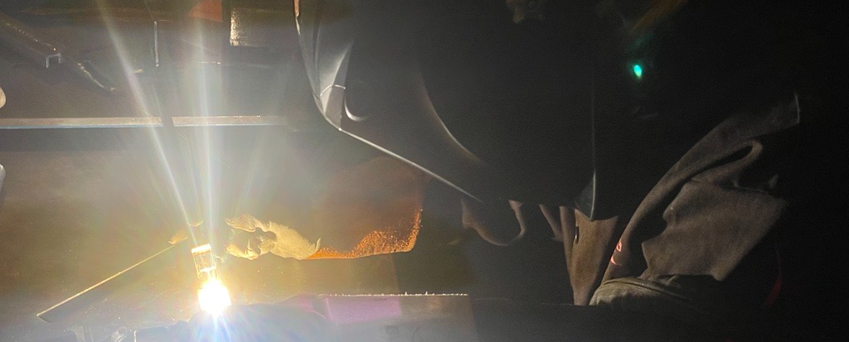
Appendix

Slide 11
Works Cited
Chalmela, R. J. (2016). Electro-Pneumatic shifting and servo control of a clutch for a FSAE racecar.
Kennett, A. J. (2008). Design of a Pneumatically Assisted Shifting System for Formula SAE Racing Applications.
Pittman, R., Hmeidan, M., Feschak, S., & Castillo, K. (2015). Formula SAE Paddle Shift System [Review of Formula SAE Paddle Shift System].
Sundge, R., Bramhankar, T., Bhujbal, A., & Barve, T. (2022). Design of gear shifting assembly using paddle shifters and electric solenoid for FSAE vehicles. International Research Journal of Engineering and Technology.
Tyagi, C., Verma, S., Pandey, A., Prasad, D., & Nath, V. (2019). Study and design of electro-pneumatic shifting system. Lecture Notes in Electrical Engineering, 481–488. https://doi.org/10.1007/978-981-13-7091-5_39
United Nations. (2015). The 17 Sustainable Development Goals. United Nations. https://sdgs.un.org/goals

